Slide 1
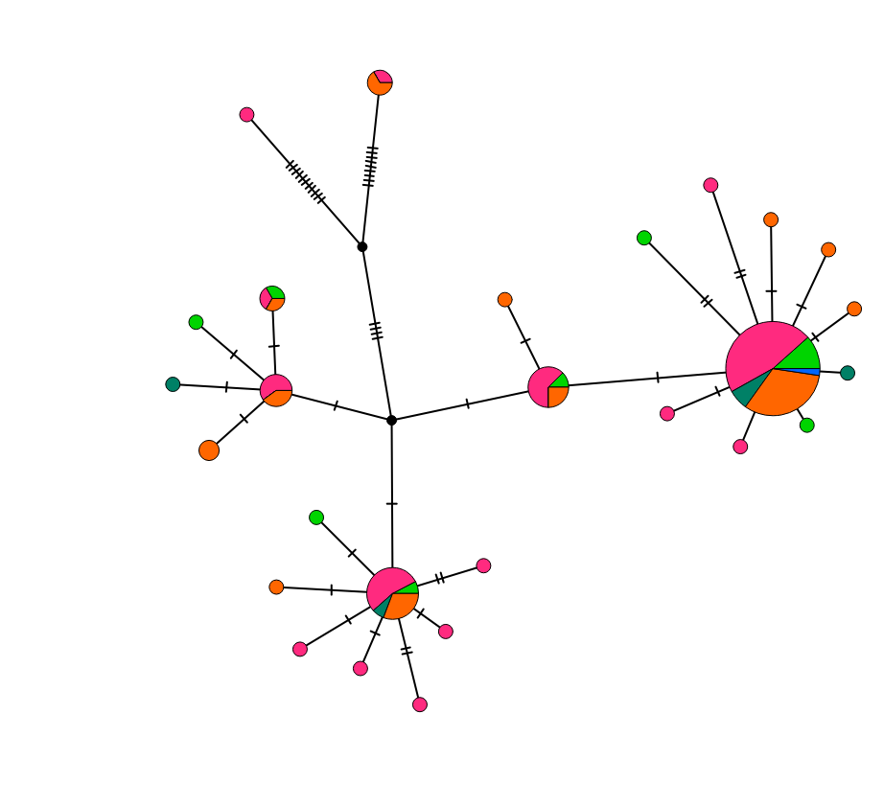
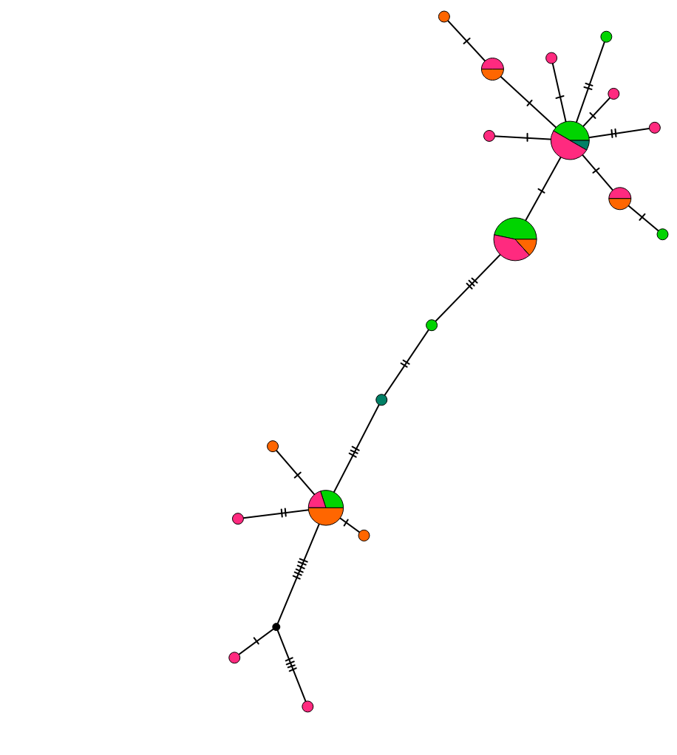
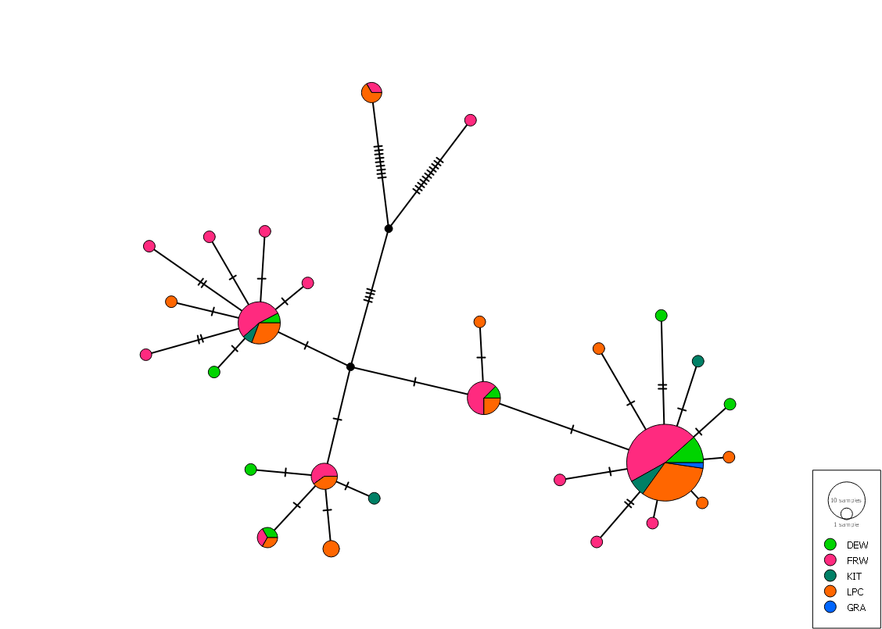
Number of Samples
Dew Line Road
Freshwater River
Grenier Lake
Long Point Creek
Gravel Pit
10
1

Slide 2
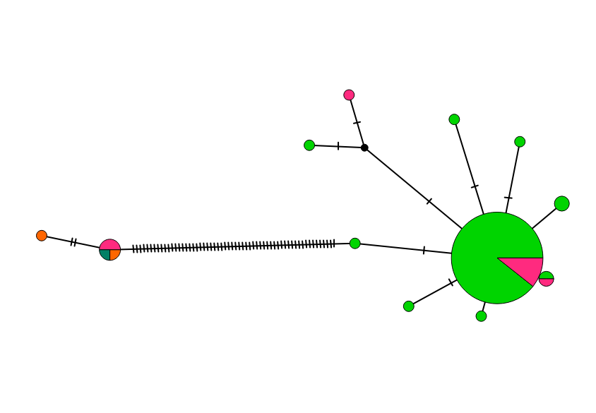
Number of Samples
Dew Line Road
Freshwater River
Grenier Lake
Long Point Creek
10
1

Slide 3
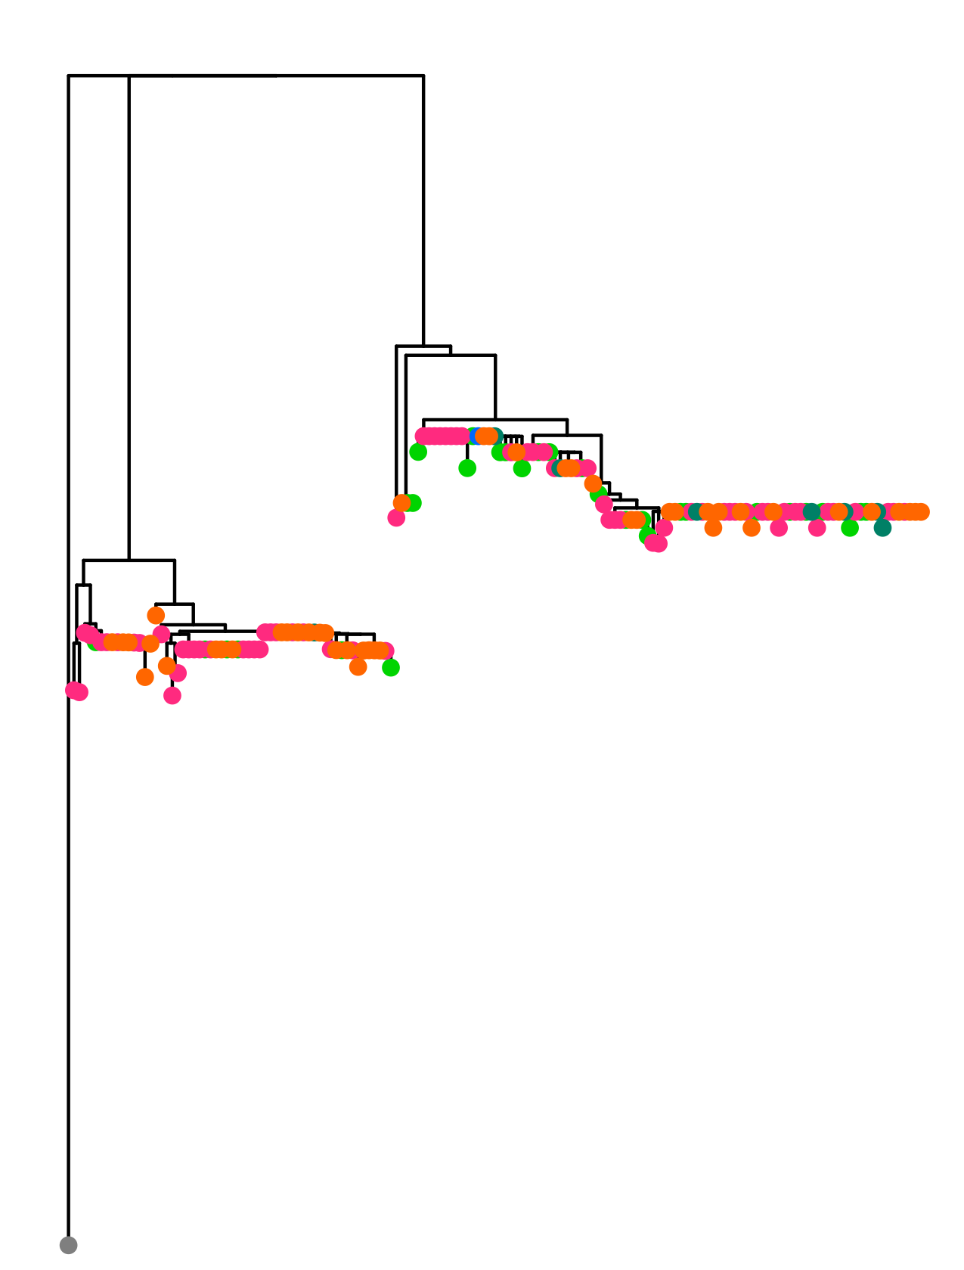
Sampling location
Dew Line Road
Freshwater River
Grenier Lake
Long Point Creek
Gravel Pit
Outgroup Root

Slide 4
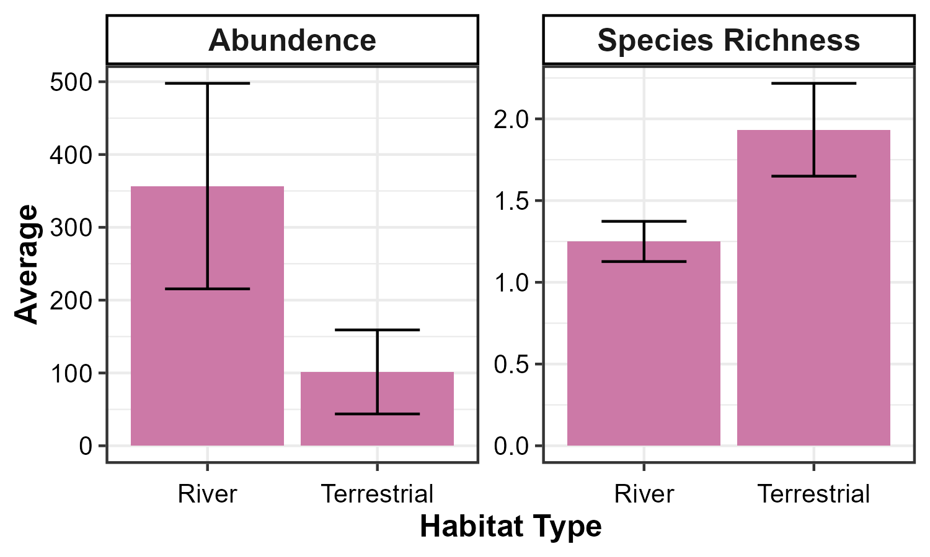
*
**

Slide 5
